Slide 1
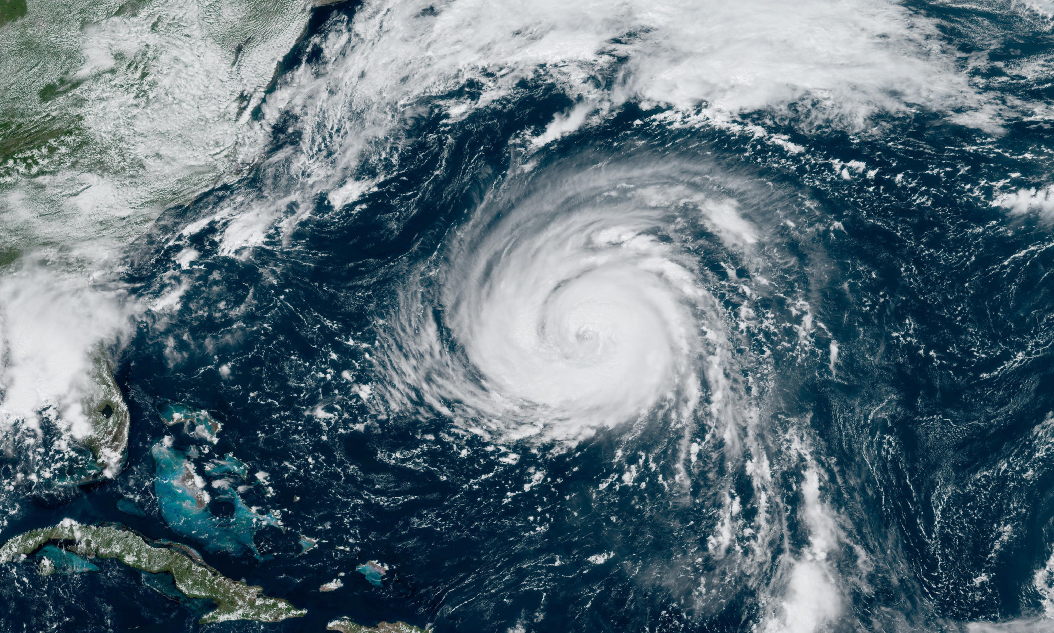
Hurricane Impact.
1.

Slide 2
Dataset:
The Data is collected from the satellite for the estimation of the Hurricane behavior, that happened in Texas. The dataset consists of images that are divided into binary groups, labelled with the damaged and non-damaged building structures along with Geo – coordinates as file names.
Problem:
The Hurricane destroyed a large number of structures in the prone area, the goal is to classify the images based on the satellite images through a predictive model.
2.

Slide 3
Method:
The goal of this problem is to build a neural network that can classify the structures whether they have been damaged due to the impact of the hurricane.
EDA – Exploratory Data Analysis.
Custom CNN.
SOTA DNN.
Transfer Learning.
Compare the SOTA model’s performance.
Classify image data from the dataset.
3.

Slide 4
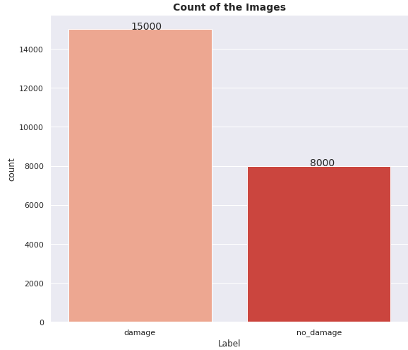
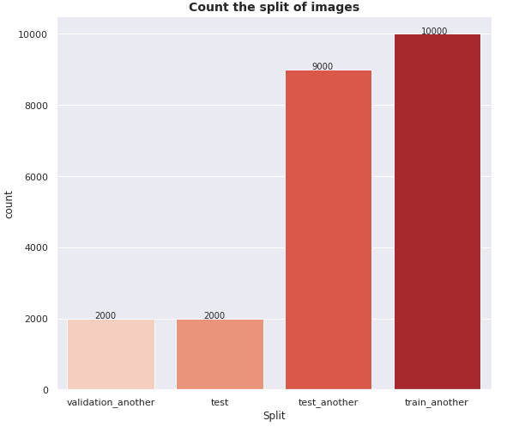
EDA:
The dataset consists of 23000 files in total, having (128,128) - 3 channel image data. There are 15000 damaged structures and 8000 no-damaged structures in the dataset.
We have split the dataset according to our need to train, test and validation for the model construction.
4.

Slide 5
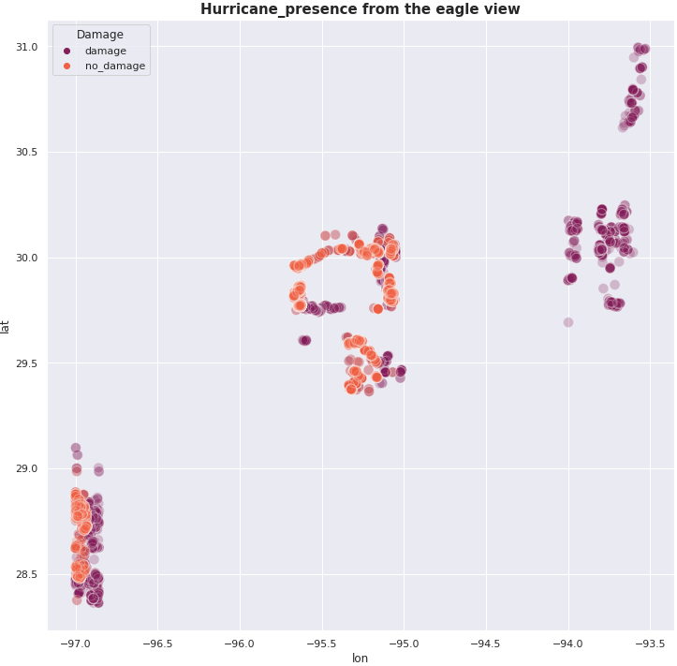
EDA:
The plot gives us details of the impact caused by the hurricane. we can observe the impact has happened mainly in 3 different zones. They are plotted by the label as per binary details as damaged and not - damaged.
Zone_A:
The cluster environment of lon_range(-97.0) and lat_range (28, 29.0) is having a strong impact on the hurricane.
Zone_B:
The cluster environment of lon_range(-95.8, 95.0) and lat_range (29.3, 30.1) is having a spiral impact.
Zone_c:
The cluster environment of lon_range(-94.0, -93.5) and lat_range (29.8, 31.0) is having a vertical impact but it is not a severe impact when compared to the above two zones.
5.

Slide 6
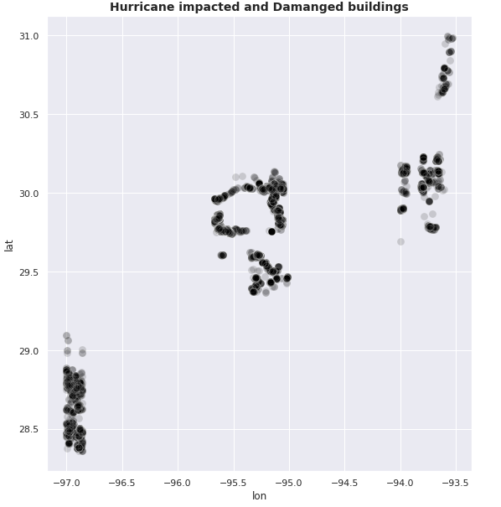
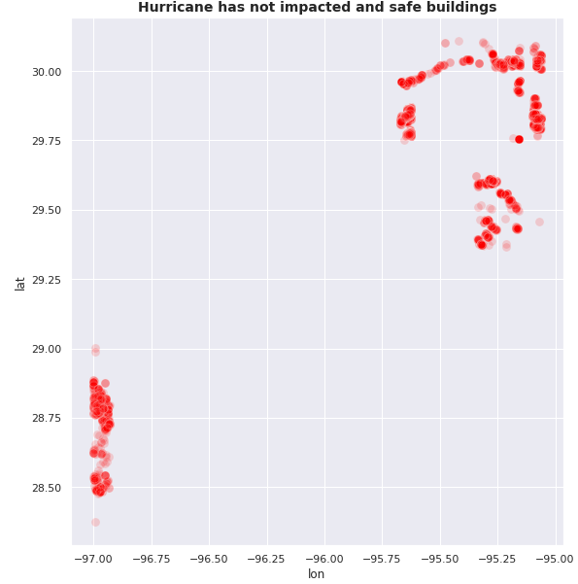
EDA:
The Hurricane’s impact is shown in an eagle view of the damage there are 15000 impacted structures as per the data scattered with respective geo-coordinates.
During the Hurricane, there are 8000 not impacted structures. At zone_b there is no structure not been impacted by the hurricane every structure at the zone_b is been impacted.
6.

Slide 7
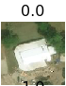
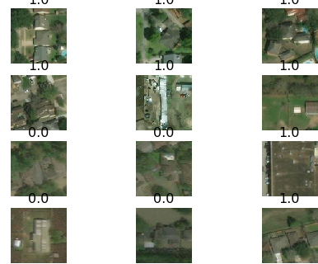
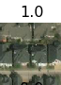
EDA:
The Hurricane’s impact is shown in a satellite view of the damage there is 0.0 shows the impact of damage and 1.0 shows no damage.
Damaged:
Non-Damaged:
7.

Slide 8
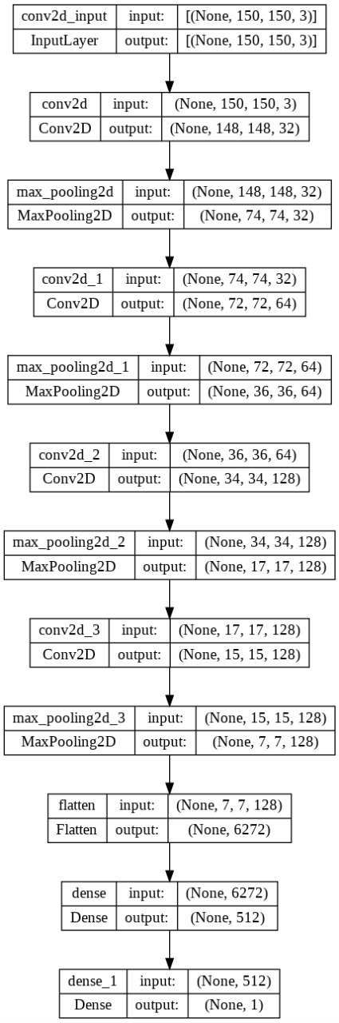
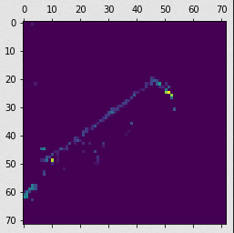
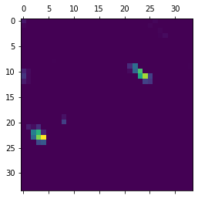
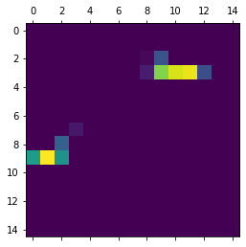
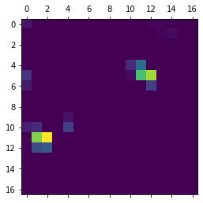
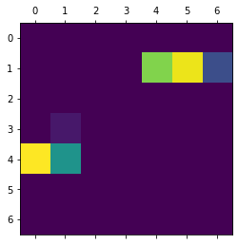
Custom Model :
In the custom model, we have created the sequential model with 4 layers of Convolution by a cumulative increase np. of filters starting from 32 to 128.
Kernel_size of (3,3).
Activation Relu.
Max pooling with a pool size of (2,2) by 4 layers.
Connected with 512 units of neurons.
Output activation as Sigmoid and single unit.
Training with 3,453,121 parameters.
Class Activation Maps with in custom CNN
8.

Slide 9
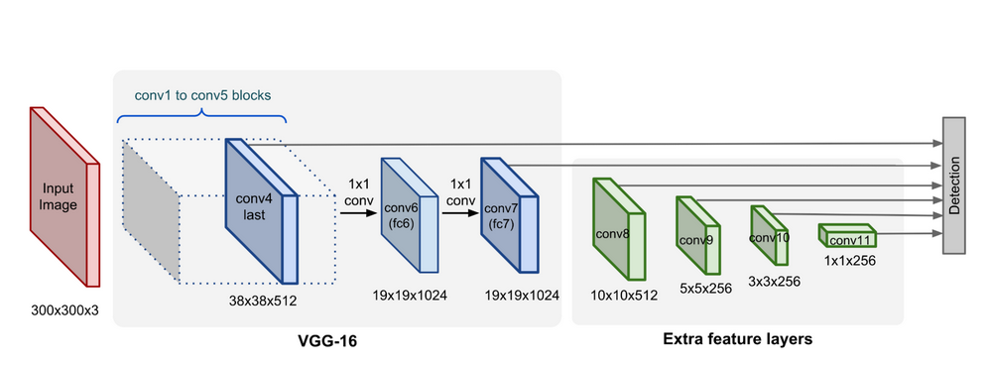
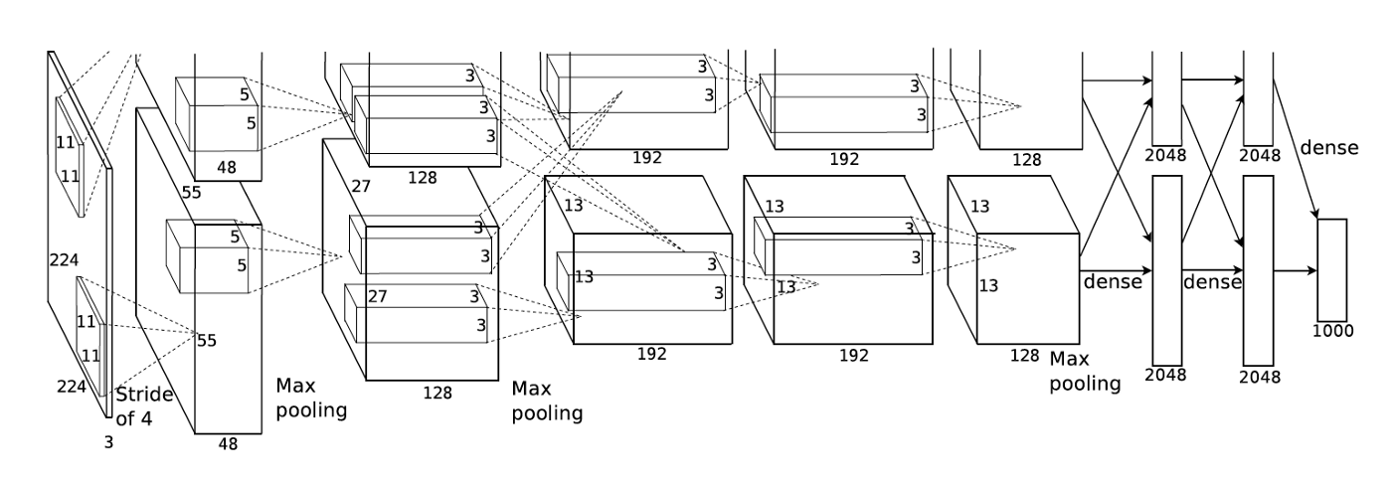
SOTA DNN with Transfer learning:
we have used SOTA DNN architecture for comparison purposes in terms of efficiency, performance, and depth. The 3 architectures we have used are:
VGG16
AlexNet (structure)
9.

Slide 10
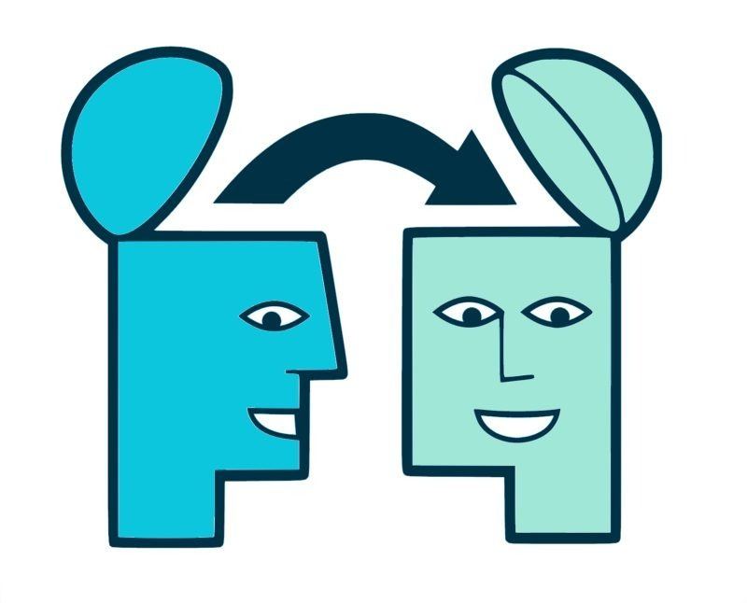
Transfer learning:
Transfer learning is a technique in which a model that has already been trained on a task is used as a starting point to train a model on a new, related task. This allows for faster progress on the new task because the model has already learned some relevant features and patterns from the original task. In other words, transfer learning involves using a pre-trained model as a basis for a new model, with the aim of improving performance on the new task.
VGG16 Transfer learning:
VGG16 is a deep neural network with 16 layers, hence the name VGG16. One of the key features of the VGG16 model is its use of small convolutional filters (3x3) and a deep architecture, which allows it to learn more robust features from the input images. The model achieved state-of-the-art performance on the ImageNet dataset at the time of its release.
10.

Slide 11
Conclusion:
From Texas Counties and Damage Locations plot, we can infer that majority of Destruction happened in Location Ranging From Longitude -95 to -97 and latitude 28 to 30.
2) Irrespective of Base model "Sigmoid" is the perfect activation function for the Final layer with 1 Node as we have a Binary Class to predict.
3) AS you can see Due to Transfer Learning, model's training time was drastically reduced. Hence the VGG-16 Model Performed the best which proved itself f low tit selfies Computationally expensive and gives Great Accuracy and lowest loss with a very less number of epochs than other models.
4) All models gave us a validation accuracy of around 95% which indicates Classification is successful have successful solution images in dataset.
10.

Slide 12
THE END.

